Slide 1
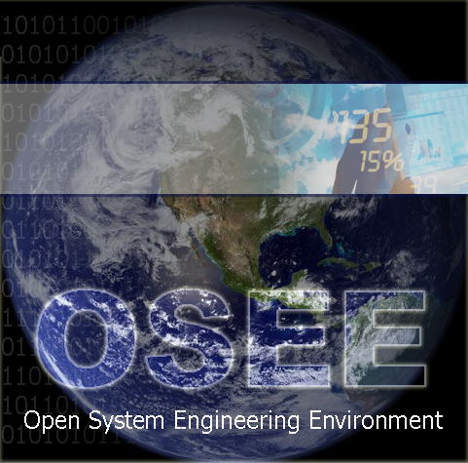
The Cure for Your Disconnected Toolset Headache
http://www.eclipse.org/osee/
EclipseCon 2008
2008-03-18 - 10:10 - Room 207
Don Dunne, Jeff Phillips, Ryan Brooks
Copyright © 2008 Boeing. Made available under the Eclipse Public License.
Notes:
Don: 15 min
Jeff: 10 min
Ryan Demo: 10 min
Ryan: 10 min

Slide 2
Problem
CVS
SVN
DB
DB
DB
File
Sys-
tem
DB
Requirements
Management
Modeling
Design
Implementation
(JDT,CDT,ADT…)
Validation
Integration
Verification
Application
Tools
Eclipse
Notes:
Starts with Eclipse - Premiere framework for integration of tool user interfaces.
Download and build all the applications necessary to support full development lifecycle
Many organizations loosely integrate tools using point-to-point data synchronization.
Costly to create
Impedes the flow of information through the development lifecycle
Difficult to maintain.
Each large program that develops systems and software is currently required to assemble a wide array of software products to provide piecemeal capabilities necessary for completing different stages of the engineering lifecycle. Once installed, the daunting task of configuring and gluing them together begins. The resulting tools are disconnected, sporadically maintained, and use an overwhelming array of disjointed user interfaces to access partially redundant data.

Slide 3
Solution
OSEE Built-In and Third Party Applications
Requirements
Management
Modeling
Design
Implementation
(JDT,CDT,ADT…)
Validation
Integration
Verification
Common
Shared
Datastore
OSEE
OSEE Application Framework
Eclipse
Relational DB
Notes:
Define Artifact
OSEE provides a common and extensible artifact framework for persistence of data
Built in OSEE applications such as Requirements Management, Validation and Verification tools already exist
Third Party Tools such as Modeling, Design, Implementation Applications can be “plugged” in
All share a simple common object data storage providing:
1) Version Control to the Attribute level
2) Access Control
3) Typed Relationships Between Objects

Slide 4
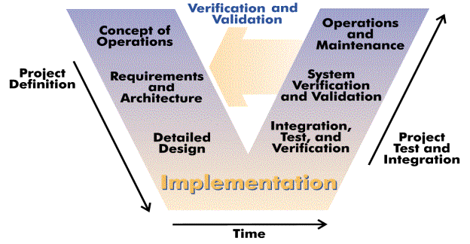
V-Model / Systems Engineering
OSEE provides a tightly integrated environment that supports lean engineering. It is integrated around a simple, user-definable data model to eloquently provide bidirectional traceability across the full product life-cycle including: architecture and design, requirements management, implementation, verification, and validation.
Image Source: http://en.wikipedia.org/wiki/V_model
Notes:
Systems engineering is defined as "a branch of engineering whose responsibility is creating and executing an interdisciplinary process to ensure that customer and stakeholder's needs are satisfied in a high quality, trustworthy, cost efficient and schedule compliant manner throughout a system's entire life cycle, from development to operation to disposal.” INCOSE
Although OSEE was born out of Engineering Flight Software for Boeing Apache Attack Helicopter, it can be applied to all systems engineering from smallest 1-2 person project to large 1000 person DoD program. == Not just an Avionics Platform
No matter the size, it’s imperative to ensure that customer requirements are being met. For many projects, this is an after-thought or something to verify at delivery. This is due to complexity of tracking requirements all the way down to application code and unit tests.
With the ability to store and relate all the data at time of creation, it is possible to maintain and ensure that requirements are being decomposed and met and see live metrics throughout the project.
Open Source Extensible Platform
Open Eclipse Project w/ Collaboration
Tight Integration Around A Common Data Model
Full Lifecycle Engineering Environment

Slide 5
Third-Party Extensions and Legacy Software
Java/C/C++/Ada Dev
Backup/Restore
Multi Configuration
Project Mgmt/Planning
Building/Releasing
Team Config
Workflow Config
Metrics
Rich Traceability
Process Mgmt
Document Mgmt
Requirement Mgmt
Visualization
Blam Operations
Rules Framework
Publishing
Reporting
Messaging
Results Analyzer
Real Time Testing
Unit Testing
Reporting
Security
Task Scheduling
Database Analyzer
Training Services
Exemplary Applications Extensible Frameworks
Application
Development
Configuration
Management
Systems
Engineering
Requirements
Management
Testing
Environment
OSEE Application Framework
TPTP
Mylan
Plugin Dev Utilities
Extensible Rendering
Remote Event Service
Indexing & Tagging
Dynamic Searching API
Dynamic Artifact Model
Multi-Level Transactions
Multi-Level Branching
Data Store Adapter
Access Control
Version Control
User Mgmt & Authentication
Object-Oriented Persistence
Web Tools Platform
BIRT
Nebula
CDT
JDT
Other
Eclipse Platform
Java Virtual Machine
JINI (Peer-to-Peer)
Relational DB (Oracle/PostGreSQL)
Operating System (Windows, Linux, OSX, Solaris)
Notes:
OSEE’s Architecture extends the Eclilpse Platform and provides it’s own extensions for use by the Applications that are built on top.
OSEE Application Framework provides the services necessary for the applications to share the common data model
Custom, Non-Engineering Environment Applications can be built on OSEE Application Framework and delivered to customers
OR Additional Applications can be plugged in to enhance OSEE’s already existing applications

Slide 6
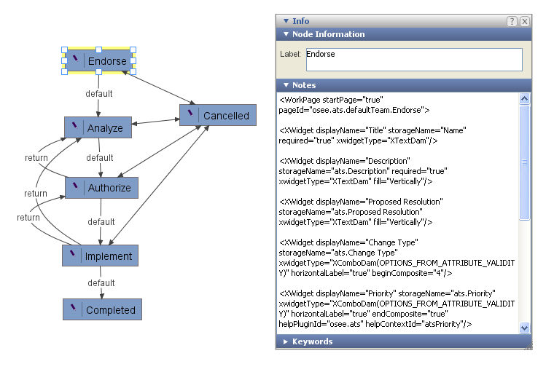
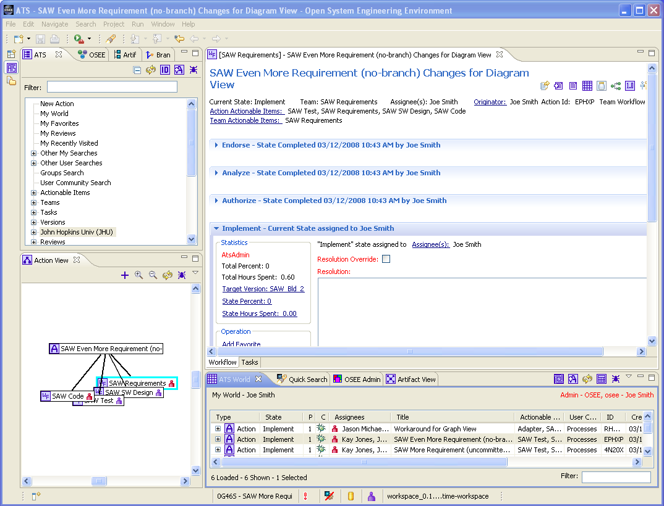
Integrated Process and Workflow
Integrating processes and workflow into OSEE allows engineers to focus more on engineering and less on process training and manually reporting metrics.
Workflows are graphically defined and stored in OSEE
Widgets are specified using XML mapping widget to storage item
Processes are defined through workflow, permissions and rules

Slide 7
Bidirectional Traceability
Requirements Traceability
Product Decomposition
System
Requirement
System
Requirement
XYZ
Allocation
Requirement trace
Subsystem
Requirement
Subsystem
Requirement
Subsystem
Requirement
NAV
…
COM
Allocation
Design
Software
Requirement
Software
Requirement
XYZ
ABC
RST
EFG
Subsystem
Design
Implementation
Verification
OSEE allows the creation and storage of requirements, design, code and test and maintains their relationships. These artifacts can be grouped through other relationships such as allocation or functionality.
Code
Unit
Automated
Test
Test
Procedure
Code
Unit
Notes:
Side names strongly type specific constrains with max and mins

Slide 8
Manage Variants / Product Lines
OSEE manages product lines by sharing common baseline data throughout all variants. Changes to the baseline product can be easily merged to the variant product lines.
Product A
Release 1.0
Release 2.0
Release 3.0
Product A.2 (Product A w/ Additions)
Product A.3 (Product B w/ Additions)
Time

Slide 9
OSEE Application Framework
Requirements
Management
Modeling
Design
Implementation
(JDT,CDT,ADT…)
Validation
Integration
Verification
OSEE Application Framework
Access
Control
Extensible
Rendering
Remote Event
Service
Multi Level
Transaction
Multi Level
Branching
Advanced
Searching
Notes:
The OSEE Application framework is composed of several key functions

Slide 10
Simple, User-definable Data Model
Artifact
Software Requirement
Name: Display Versions
Design Assurance Level: E
Paragraph number: 1.1
Test Unit
Name: VersionTester
Source: <source code>
Attribute
Verification
Relation
Notes:
The main components of the data model are:
Artifact – data objects
Attribute – state data on artifacts
Relations – Link artifacts to one another
All data types are strongly type and user definable

Slide 11
Transaction-Based Revision Control
Transaction based version control with fine grained change identification
Transaction: 1000021
Timestamp: Mar 4, 2008
Author: Terry Bahill
My Requirement
My Code unit
Time
Transaction: 1000020
Timestamp: Mar 3, 2008
Author: Alan Turing
My Requirement
My Code unit
My Test unit
Transaction: 1000019
Timestamp: Mar 2, 2008
Author: Terry Bahill
My Requirement
Notes:
Revision control is a transaction based model
Changes can be arrogated within a single transaction to support data consistence
Transactions can be deleted to remove erroneous changes

Slide 12
Multi-Level Branching
Branching, merging conflicts, committing and update artifacts from other branches
Working Branching A
Commit
Program A
Working Branching B
Merge &
Commit
Update Artifacts
Program B
Notes:
Baseline branches
Working branches
Merge instead of locking artifact changes
Commit

Slide 13
Deep Collaboration
“The historical way of developing products just doesn't work when you're as ambitious as we are. When the challenges are that complex, you have to develop a product in a more collaborative, integrated way.¹”
Jonathan Ive, head of design – Apple
Engineering a product in a more collaborative, integrated way requires an environment that is itself tightly integrated.
¹ Grossman, Lev. "How Apple Does It" Time 24 Oct 2005. <http://www.time.com/time/archive/preview/0,10987,1118384,00.html>.
Notes:
Enable automated, concurrent flow of information
Lean because you can Embrace Change
Minimize knowledge loss

Slide 14
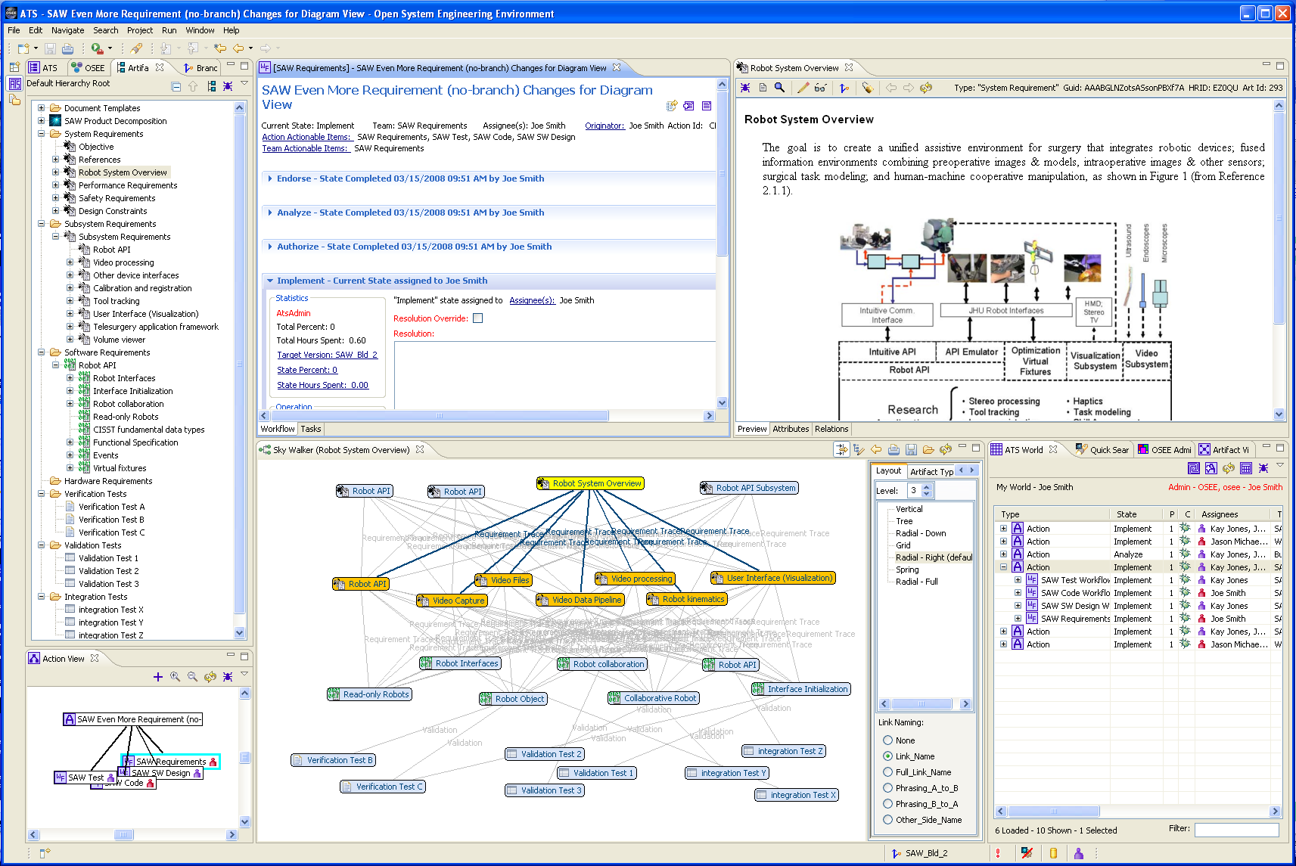
Traceability Demo

Slide 15
Beyond Vertical
Full Engineering Environment
User-definable Data Model
Customizable through OSEE views, preferences, etc.
Fully Extensible through Eclipse Extension Points
Aerospace
Industry
Your
Industry
Automotive
Industry
Aerospace
Extensions
OSEE
Applications
Automotive
Extensions
OSEE Application Framework
Notes:
Extensible

Slide 16
Why OSEE?
Other Tools Sound Similar: Why OSEE?
Full Lifecycle Engineering Environment
Tight Integration Around a Common Data Model
Highly extensible and tightly integrated version control and change management
Open Source Extensible Platform
Benefits of Collaboration through an Eclipse Project

Slide 17
Key Project Activities and Timeline
Nov 2004 – Test Environment first used for requirements verification in simulated environment
EclipseCon 2007 – Explored idea for Eclipse project
July 10, 2007 – Project proposal approved
Aug 10, 2007 – Incubation Phase (conforming)
Nov 8, 2007 – Delivered OSEE w/database to US Army
Dec 8, 2007 – Initial source commit (140K LOC)
Summer 2008 – Next major source commit: Test Environment for embedded software (45K LOC)
Summer 2008 – Upcoming first flight of next generation Apache Helicopter represents major maturity milestone for OSEE
Notes:
Eclipse and Industry Verticals: The healthcare experience by Grahame Grieve
Test Environment for Simulated and Real-time embedded testing

Slide 18
OSEE Collaboration
7 talented committers
4 contributors
Recruit and mentor new contributors and committers
Work with interested parties including:
Integration with other Eclipse Projects
Arizona State University | Auburn University
Bosch | EADS
Lockheed Martin, Advanced Technology Laboratories | Rockwell Collins
General Motors | United States Army
OSEE BOF - Wednesday - 7:30pm - Room 207
Notes:
Eclipse and Industry Verticals: The healthcare experience by Grahame Grieve

